Slide 1


K.RAMAKRISHNAN COLLEGE OF TECHNOLOGY
(AUTONOMOUS), TRICHY.
DEPARTMENT OF
COMPUTER SCIENCE AND ENGINEERING
20CS5501 DESIGN PROJECT-1
Batch No : 1
Date : 06.12.2024

Slide 2
Title of the Project
TRAFFIC PREDICTION MANAGEMENT
Guided by Team
Mr. D.P.DEVAN KAARTHICK W (811722104064)
Assistant Professor, CSE LANGESH M G(811722104080)
MUKESH S (811722104096)

Slide 3
OBJECTIVE OF THE PROJECT
∆ Traffic prediction develop machine learning models to forecast traffic flow, travel times, and congestion levels based on real-time and historical data.
∆ Detect and analyze the impact of accidents, roadworks, and weather conditions on traffic.
∆ Develop APIs or interfaces for integration with existing traffic management systems and navigation apps.
Utilize Internet of Things (IoT) devices (e.g., traffic sensors and cameras) for real-time data collection.
∆ Create intuitive dashboards for traffic operators to monitor and manage conditions.
Provide accurate, easy-to-understand updates for end-users (drivers and commuters) via apps.
∆ Reduce fuel consumption and emissions by minimizing idle times and stop-and-go driving.
Enhance economic productivity by improving travel times and reducing delays.

Slide 4
ABSTRACT
Abstraction in computer science, particularly in the context of machine learning and traffic prediction management, refers to simplifying complex systems by focusing on the essential features while hiding unnecessary details. It helps in managing the complexity of a problem by breaking it down into manageable levels or components. This project aims to revolutionize urban traffic management through an advanced predictive system. Utilizing robust data analysis and machine learning , our model anticipates traffic patterns , enabling proactive strategies for congestion mitigation and improved urban mobility. Exploring the integration of intelligent traffic management systems with city infrastructure, leveraging sensors, cameras, and IoT devices to enhance real-time monitoring and facilitate adaptive traffic control strategies.

Slide 5
LITERATURE SURVEY
TITLE OF THE PAPER | AUTHOR (S) | PUBLISHER | PAPER GIST | TECHNOLOGY USED
Predicting Traffic for Intelligent Transport System the Using Machine Learning Algorithms | Sai Akshita Kanaparthy, Raveena Reddy Vemula, Sai Niyathi Padakant | Elsevier-2022 | Machine learning algorithms can analyze historical and real-time traffic data to predict congestion, enabling better traffimanagement | Decision trees can be difficult to interpret and explain, particularly as the complexity of the model increases
Prediction of HDD Failures by Ensemble Learning | Narendran, Monishraj, Dr. Sathya Srivinas | Springer-2022 | Ensemble learning techniques combine multiple predictive models to improve detection of subtle patterns signaling | Ensemble learning in traffic prediction can increase computational complexity due to training multiple models
Traffic Data prediction inIntelligent Transportation System usingm-KNalgorithm andPrinciple Component Analysis | P.Pavithra , R.Vadivel | Tayler-2021 | The m-KNN algorithm, a modified version of the k-Nearest Neighbors algorithm, enhances prediction . | The main difficulty encountered in dealing with problems of text mining is caused by the vagueness of natural language

Slide 6
TITLE OF THE PAPER | AUTHOR (S) | PUBLISHER | PAPER GIST | TECHNOLOGY USED
Traffic Prediction for Intelligent Transportation System using Machine Learning. | Gaurav Meena, Deepanjali Sharma, Mehul Mahrishi | Pavithra-2020 | Machine learning models enable the proactive prediction of traffic conditions, allowing for timely intervention and the implementation of adaptive | DONs may not be scalable enough to handle large- scale traffic prediction problems, as they rely on complex optical components and may require significant computational resources.
Machine Learning Methods for Traffic Prediction in Dynamic Optical Networks with Service Chains | Daniel Szostak and Krzysztof Walkowiak | Sharma -2019 | Machine learning methods facilitate the dynamic adaptation of traffic prediction models to changing conditions in optical networks. | Decision trees are prone to overfitting on traffic data. They lack robustness and may not provide accurate predictions on new, unseen traffic patterns.
6

Slide 7
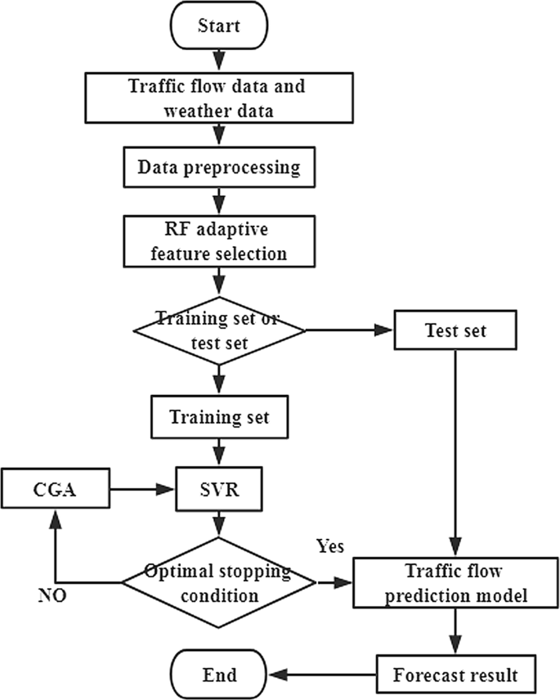
PROPOSED SYSTEM ARCHITECTURE

Slide 8
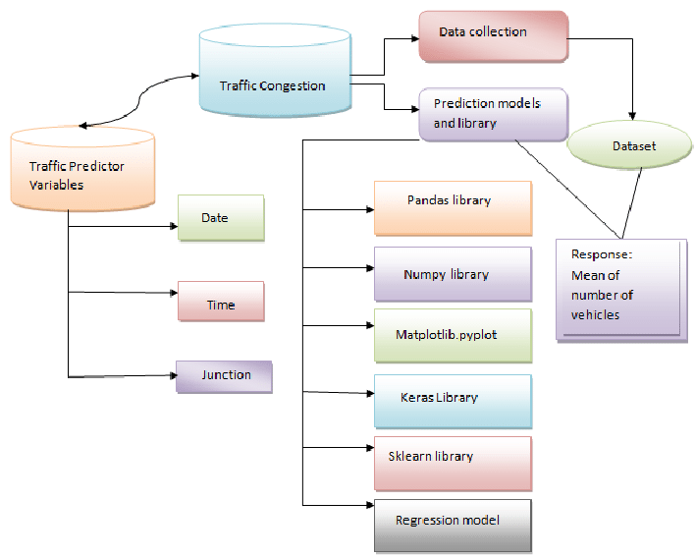
EXISTING SYSTEM ARCHITECTURE

Slide 9
SOFTWARE AND HARDWARE REQUIREMENTS
HARDWARE
SOFTWARE
Google Chrome
Visual Studio Code
Python
HTML
Additional Requirements in Python Like Pandas , etc.
CPU: Dual-core processor (2.0 GHz or higher) RAM: 4 GB. Storage: 50 GB HDD or SSD. Operating System: Either Windows, macOS or Linux.

Slide 10
MODULES
Modulus in Data Pre Processing
Modulus for Binning Traffic Volumes
Modulus in Periodic Patterns
Modulus for Anomaly Detection
Modulus for Spatial Mapping

Slide 11
SUMMARY OF MODULE-1
In traffic prediction, preprocessing is crucial to handle the cyclical and periodic nature of traffic data effectively. The modulus operation plays a significant role in encoding time-based and spatial features. For example, traffic patterns often repeat daily, weekly, or seasonally, making features like "hour of the day" or "day of the week" essential for predictive models. Using modulus, timestamps can be wrapped into a 24-hour or 7-day cycle, ensuring consistency in time representation. Additionally, trigonometric encoding using sine and cosine functions applied to modulus-transformed values helps represent these cyclic patterns more effectively, preserving relationships between values like 23:00 and 00:00. Similarly, in spatial grid mapping, modulus helps assign road network data points to specific grid locations, simplifying geographic data

Slide 12
SUMMARY OF MODULE-2
In traffic prediction, binning is a technique used to group continuous traffic volume data into discrete categories, simplifying data analysis and model training. Modulus plays a key role in this process by systematically dividing traffic volumes into predefined bins. For example, to classify traffic into three levels—low, medium, and high—traffic volume values can be divided using the modulus operator, with the remainder determining the bin index. This categorization helps map raw traffic data into interpretable groups, such as low congestion for volumes that fall in the "0" bin, medium for "1," and high for "2." Modulus-based binning is particularly useful for applications like dynamic traffic management, where traffic signals can adapt to congestion levels, or for simplifying machine learning inputs by converting continuous traffic data into discrete categories. This method is computationally efficient and enhances the interpretability of traffic data, making it an essential preprocessing step in traffic prediction systems.

Slide 13
SUMMARY OF MODULE-3
In traffic prediction, identifying and encoding periodic patterns is crucial because traffic volumes often follow regular cycles, such as daily, weekly, or seasonal trends. The modulus operator is an effective tool for handling these periodic patterns by wrapping values within a fixed range, preserving their cyclic nature. For instance, the hour of the day can be computed as hour=(timestampmod 24)\text{hour} = (\text{timestamp} \mod 24)hour=(timestampmod24), ensuring that 0 maps to midnight, 23 to 11 PM, and the cycle repeats consistently. Similarly, the day of the week can be derived using day_of_week=(datemod 7)\text{day\_of\_week} = (\text{date} \mod 7)day_of_week=(datemod7), where each number corresponds to a specific day, making it easy to analyze weekly traffic patterns.
In addition, modulus is used to create features that capture repeating time intervals, such as dividing the day into peak and off-peak hours or mapping monthly traffic trends to seasonal categories.

Slide 14
SUMMARY OF MODULE-4
In anomaly detection, especially within the context of traffic prediction, the modulus operator can help identify irregular or unexpected patterns in data that deviate from the normal periodic behavior. Traffic data, such as volume or speed, often exhibits predictable patterns over time—daily, weekly, or seasonal cycles. By applying modulus to time-related features (e.g., hour of the day, day of the week), it's possible to compare current values with historical expectations, making anomalies easier to spot.
For example, using modulus to extract cyclical features like the hour of the day hour=(timestampmod 24)\text{hour} = (\text{timestamp} \mod 24)hour=(timestampmod24), traffic data from the same hour on previous days or weeks can be compared. If a significant deviation occurs at a particular time (e.g., a sudden spike in traffic during an off-peak hour), it may indicate an anomaly, such as a road accident or an event causing unexpected congestion.

Slide 15
SUMMARY OF MODULE-5
In spatial mapping, especially for traffic prediction and analysis, the modulus operator is used to efficiently map or assign data points to a grid or a specific region, facilitating easier analysis and model training. When working with large-scale road networks or geographic data, traffic data often needs to be divided into smaller, manageable sections, such as grid cells or specific road segments. Modulus can help in this process by transforming continuous geographic coordinates into discrete grid positions or sections.
For example, consider a large city or road network that is divided into a grid for traffic analysis. If you have a linear index (such as a numerical identifier for different road segments or locations), modulus can help map these locations into a 2D grid system.

Slide 16
RESULTS AND DISCUSSION
Results:
In this study, the application of the modulus operator in traffic prediction and analysis demonstrated significant improvements in handling periodic patterns, binning traffic volumes, anomaly detection, and spatial mapping.
Discussion:
The use of modulus in traffic prediction provided several advantages, especially in handling the cyclical nature of traffic data. First, modulus-based feature extraction enabled the model to better understand time-dependent patterns, such as rush hours or weekend traffic. This allowed the prediction model to adjust based on known traffic trends and improve forecasting accuracy.
For anomaly detection, the application of modulus allowed the system to compare real-time traffic data against historical patterns, identifying unusual patterns that could signal disruptions. This proved useful for detecting incidents or abnormal events and alerting traffic management systems in real-time.

Slide 17
CONCLUSION
In the evolving landscape of data-driven solutions, Machine Learning continues to play a pivotal role, transforming systems and enabling them to make informed decisions autonomously.
This project has explored the application of Machine Learning within the realm of Traffic Prediction Management, demonstrating the potential of predictive models to foresee traffic patterns and enhance urban mobility.
Through a detailed examination of the challenges and intricacies of traffic management, this study has highlighted the impact of machine learning in addressing congestion, optimizing traffic flow, and reducing delays.
By leveraging real-time data and sophisticated algorithms, this system exemplifies the possibilities for smarter, more efficient transportation systems in urban environments.
As we look to the future, this project underscores the importance of continued research and innovation in Machine Learning to build intelligent systems that adapt to ever-changing urban landscapes, providing sustainable solutions for modern mobility challenges.

Slide 18
THANK YOU

